Slide 1


Autonomous Vehicle Relational System in Online Transportation
(AVERSOT)
Group 5

Slide 2


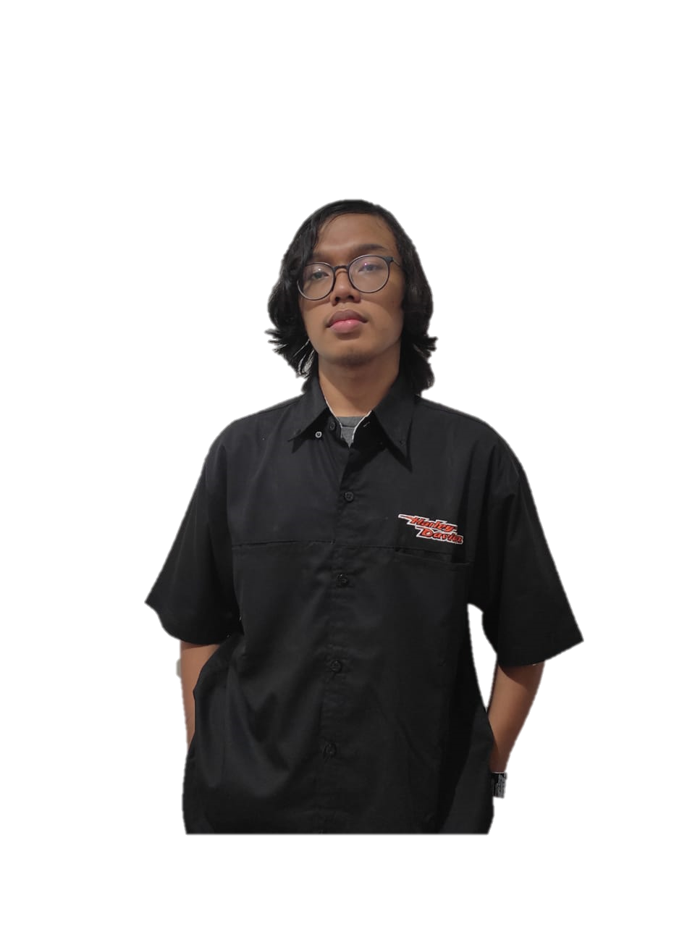
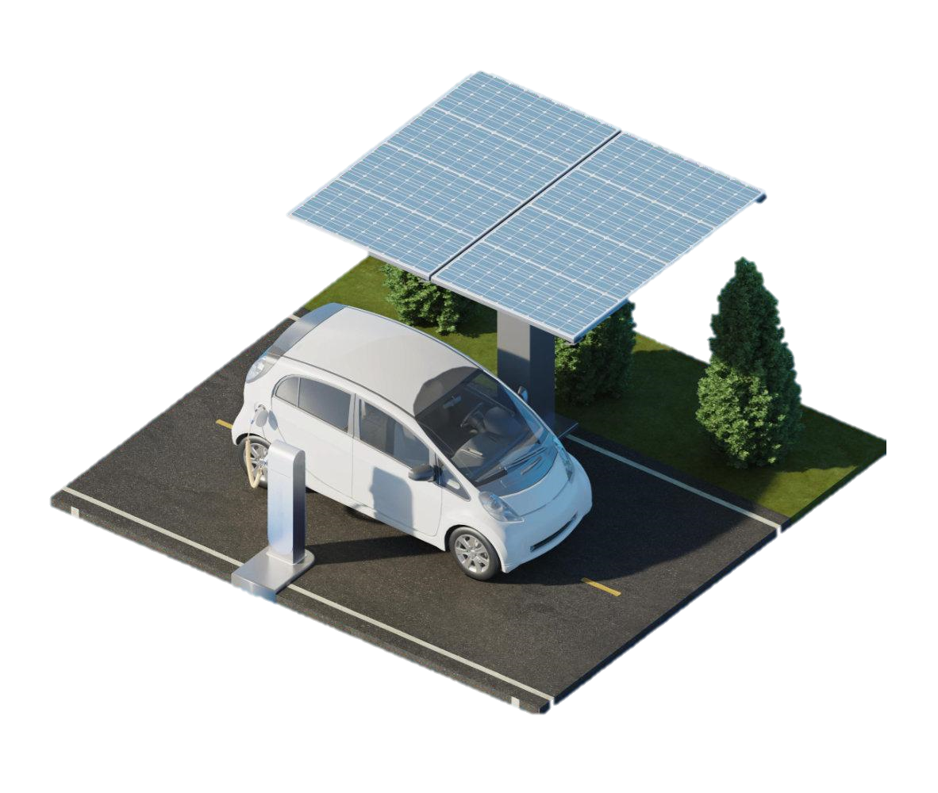
Our Team
Owen Tan Yik Wen
Riki Awal Syahputra
Muhammad Zidan Satrio
Project Manager
Project leader
Project Manager
Group 5

Slide 3
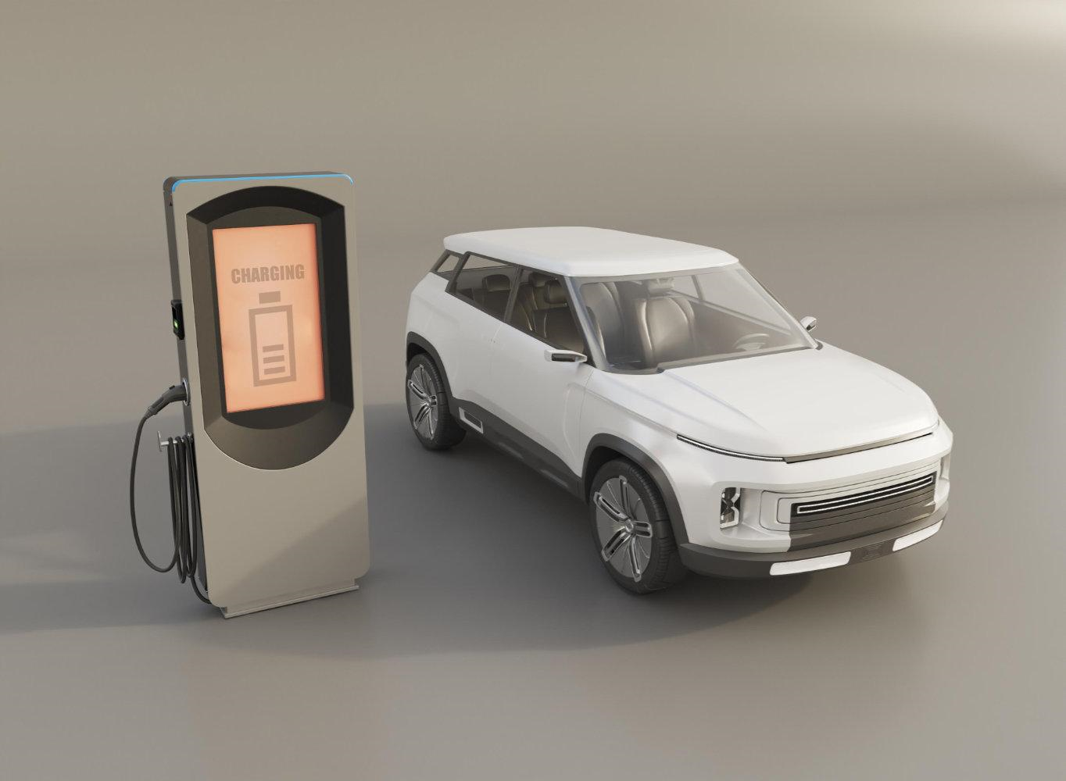
INTRODUCTION

Slide 4
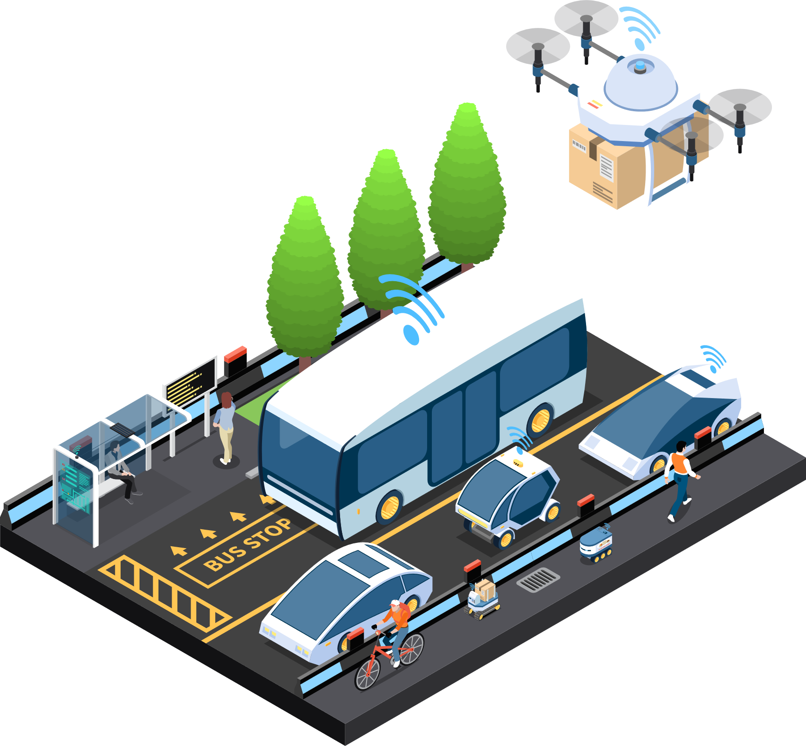
A. What is AVERSOT?
AVERSOT is the backend system of Autonomous vehicles in online transportation, handling the autonomous relational system in an autonomous vehicle system based on SQL database.
Autonomous Vehicle is a vehicle that works without driver, or driverless vehicle, it works with the help of sensor, Artificiall Intelligent, and Machine Learning.

Slide 5
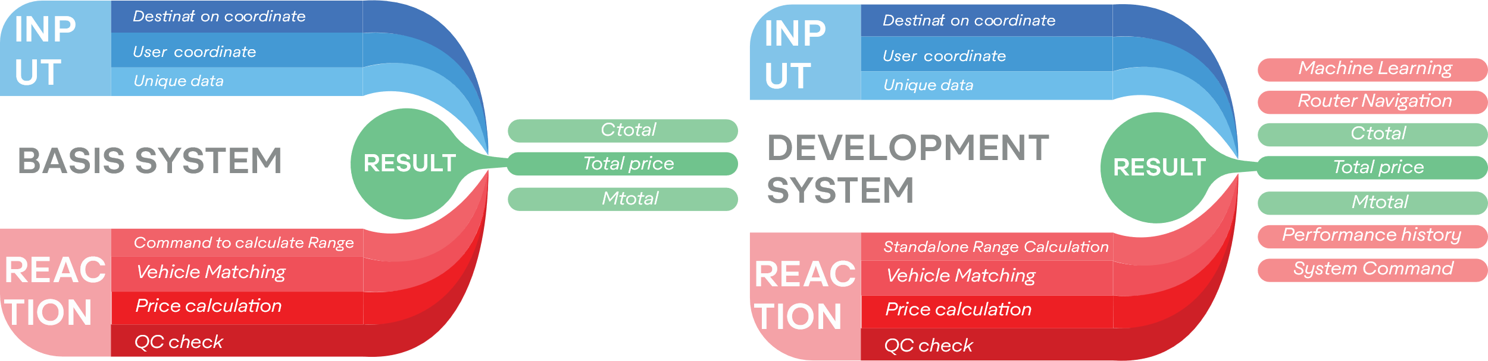
B. How AVERSOT work?
AVERSOT system is handling data management, processing, and storage of information. In this project, a basis system is used. For the development system, its prospect is for complex and standalone calculation.

Slide 6
D. Environment Benefit
No pollute
Efficiency
Zero carbon emission with no pollution
Autonomous technology minimizes the human error
Go green
Save money
Electric power with zero carbon emission ensure sustainability
Electricity is cheaper than oil fuel

Slide 7

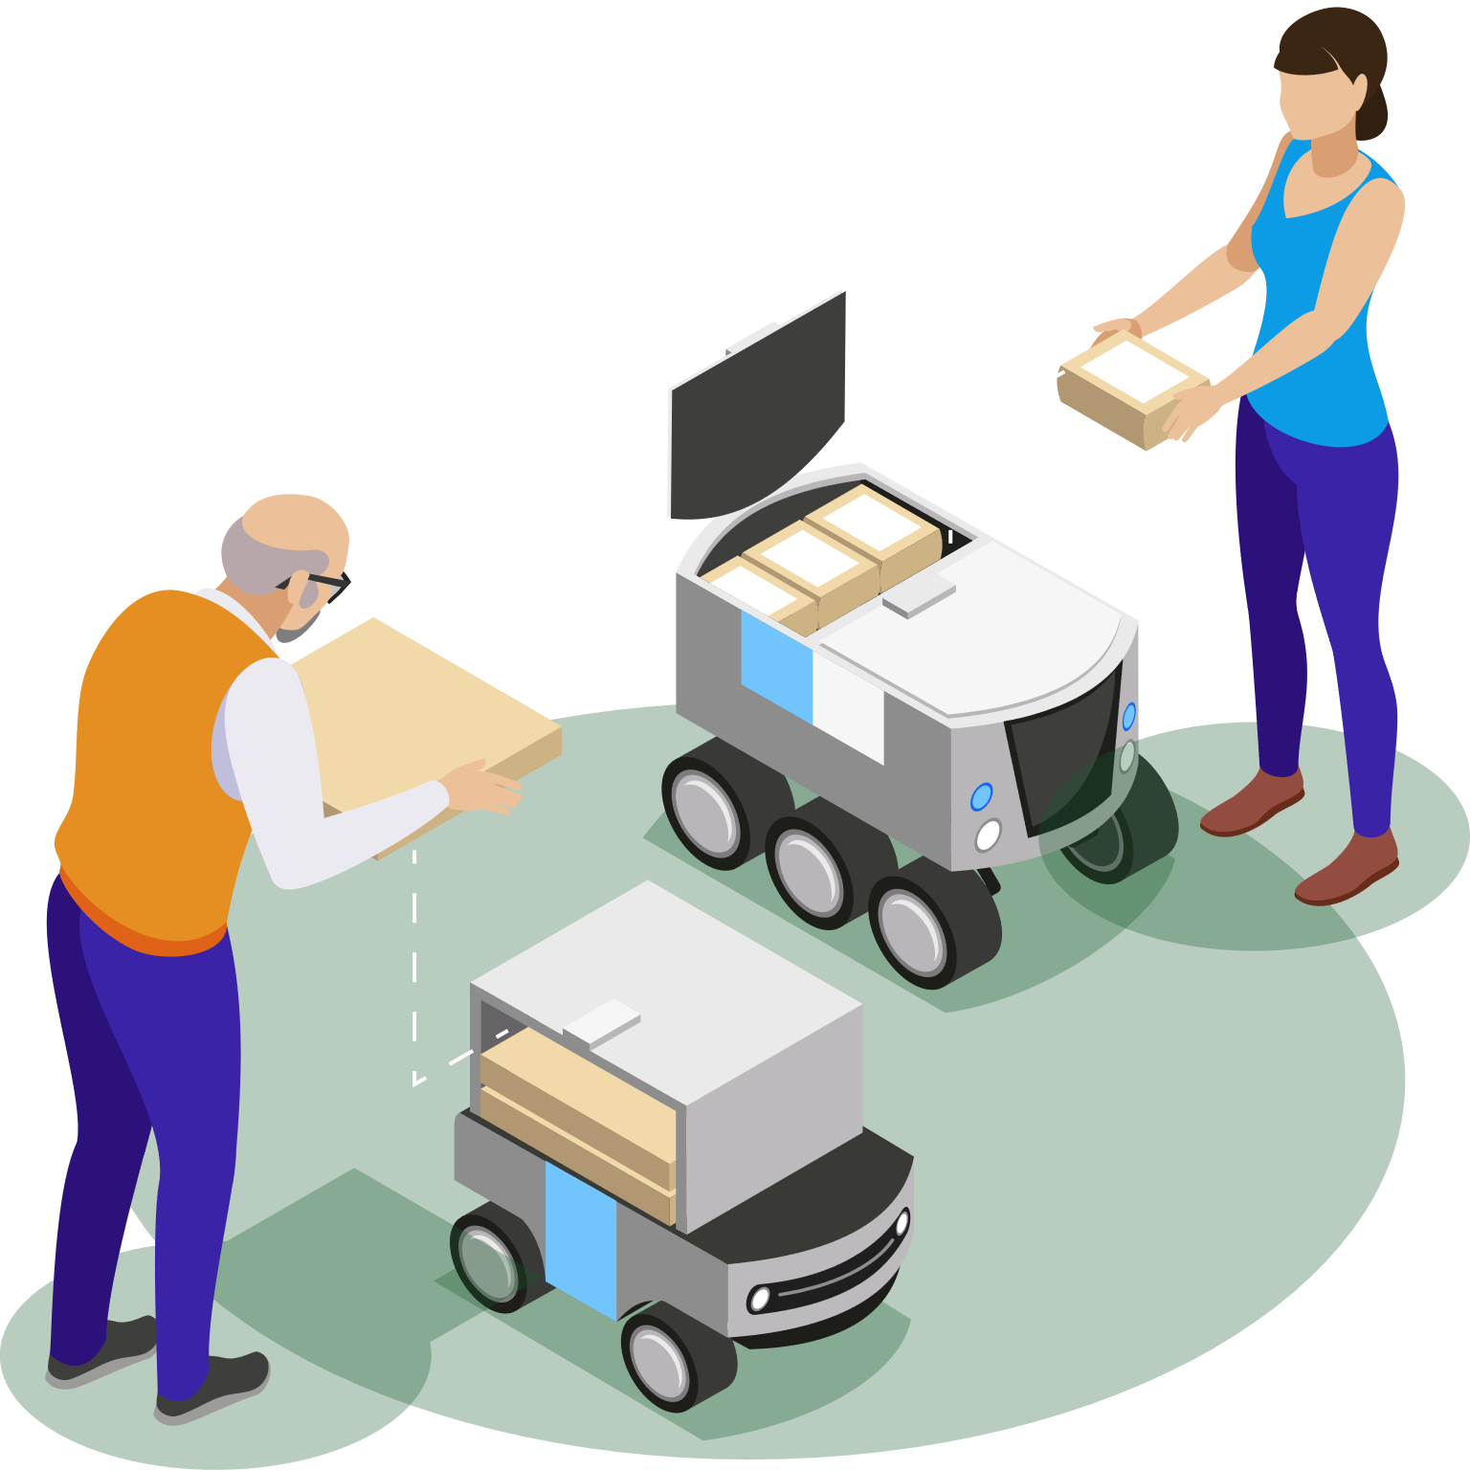

ENTITY RELATIONAL DIAGRAM

Slide 8
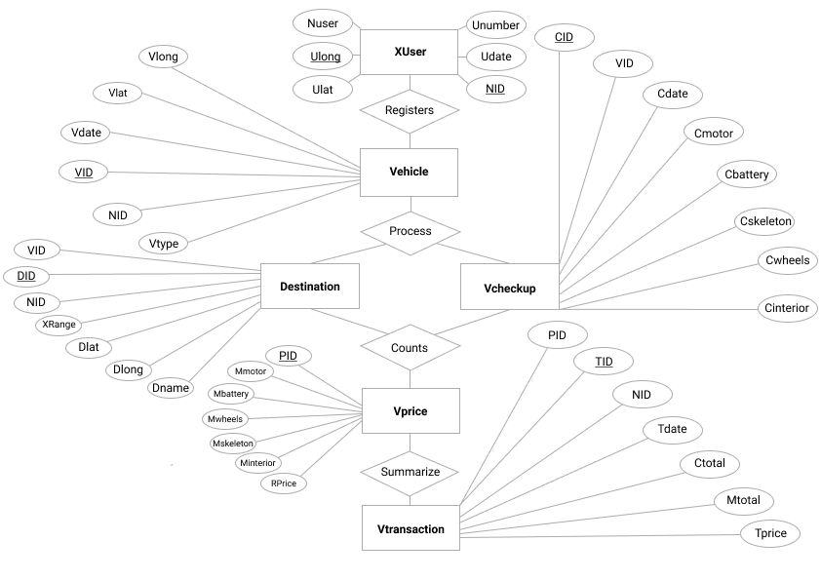
ERD

Slide 9

DATABASE DESIGN

Slide 10
DATABASE’S NAME
AVRS
TABLE TOTAL
[6]. Xuser, Vehicle, Destination, Vcheckup, Vprice, Vtransaction
PROCEDURE TOTAL
[12]Input,AddNewUser,AddNewVehicle,AddNewDestination,AddNewVcheckup,AddVtransaction,Display_Xuser,Display_NewVehicle,Display_Destination,Display_Vcheckup,Display_Vprice, Display_ Vtransaction

Slide 11
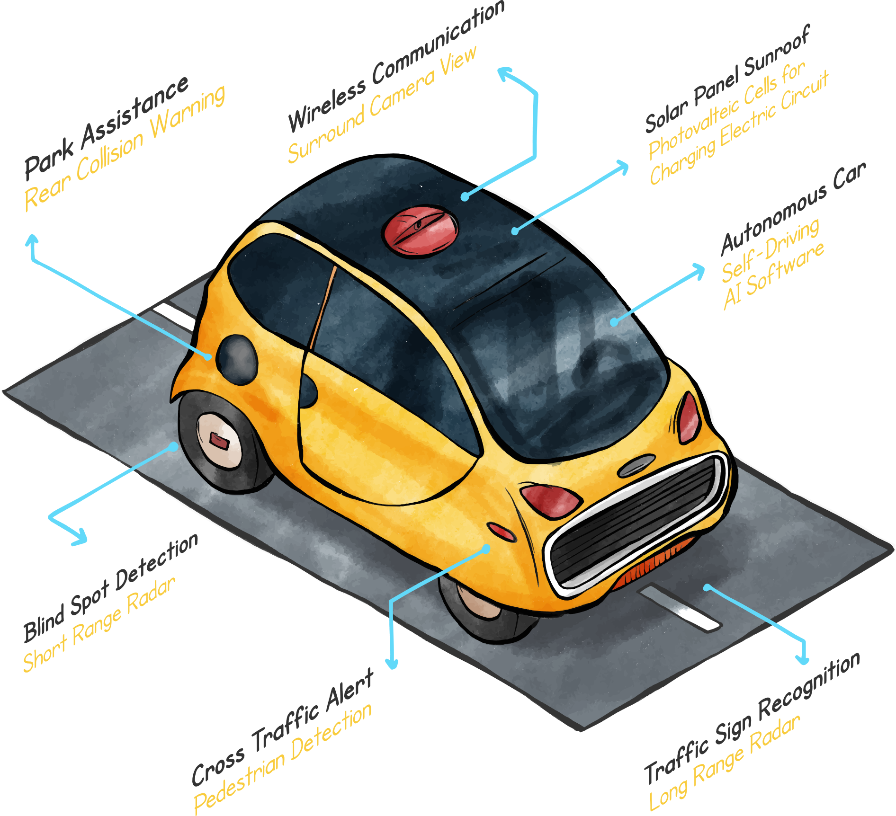
SCHEMATIC DESIGN

Slide 12
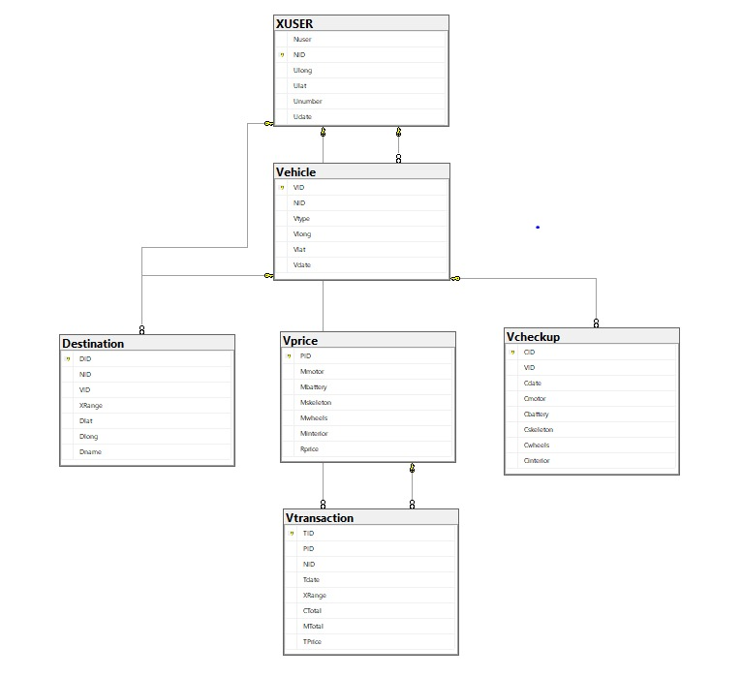

Slide 13
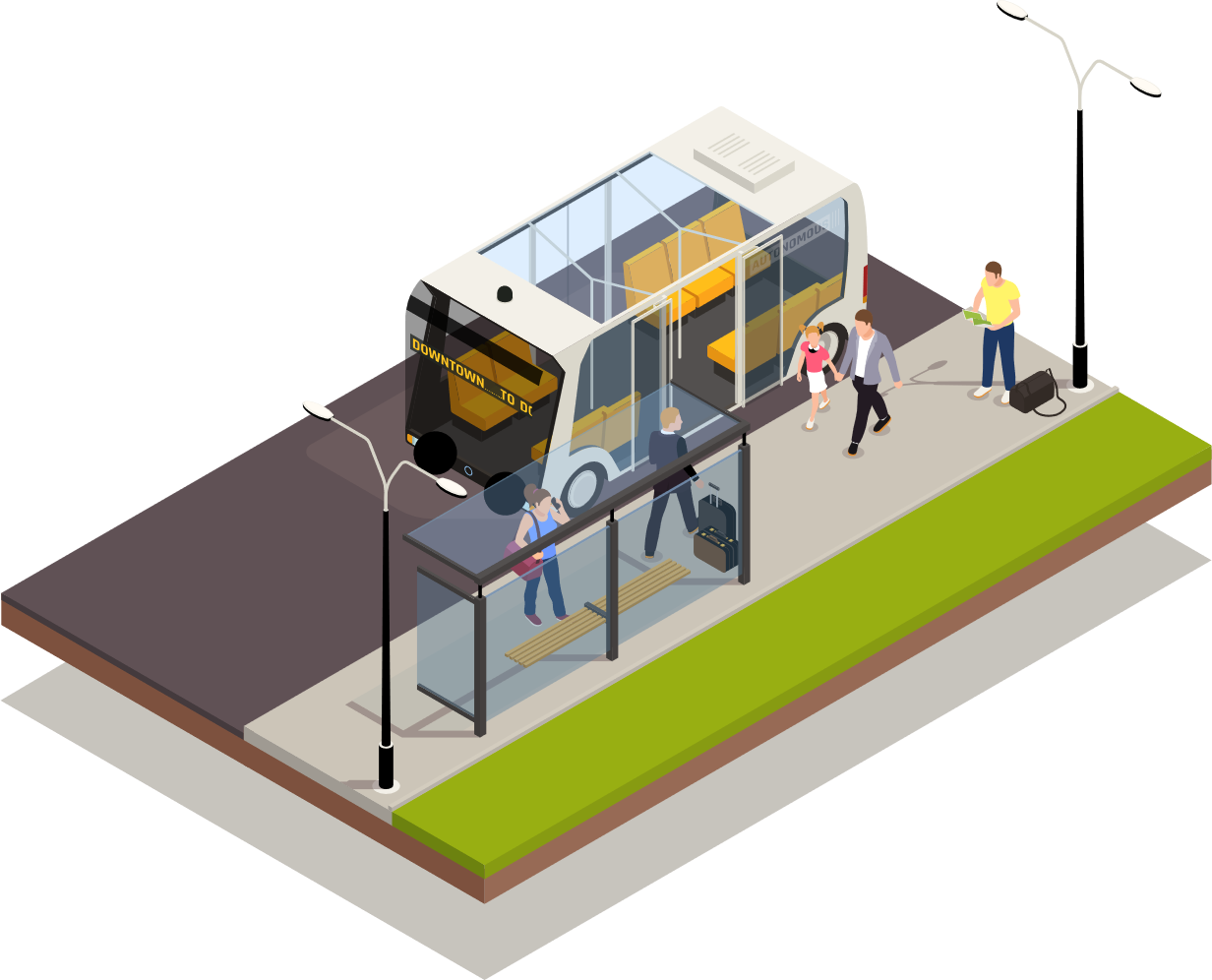
TABLE DESIGN AND VALIDATION

Slide 14
DESIGN & VALIDATION TABLE
Xuser
Column | Data Type | Width | Description | Validation | Method(s) Used for Validation
Nuser | VARCHAR | 25 | Name of user | Nuser | Not Null
NID | INT | - | User Unique ID | NID | Primary key, Not Null
Ulong | FLOAT | - | User longitude coordinate | Ulong | Not Null
Ulat | FLOAT | - | User latitude coordinate | Ulat | Not Null
Unumber | INT | - | User phone number | Unumber | Not Null
Udate | DATE | - | User order date | Udate | Not Null
DESIGN & VALIDATION TABLE
Vprice
Column | Data Type | Width | Description | Validation | Method(s) Used for Validation
PID | INT | - | Price ID | PID | Not Null
Mmotor | INT | - | Motor basis price value of maintenance | Mmotor | Not Null
Mbattery | INT | - | Battery basis price value of maintenance | Mbattery | Not Null
Mskeleton | INT | - | Skeleton basis price value of maintenance | Mskeleton | Not Null
Mwheels | INT | - | Wheels basis price value of maintenance | Mwheels | Not Null
Minterior | INT | - | Interior basis price value of maintenance | Minterior | Not Null
RPrice | INT | - | Range basis price value per km | RPrice | Not Null
DESIGN & VALIDATION
Vehicle
Column | Data Type | Width | Description | Validation | Method(s) Used for Validation
VID | INT | - | User's vehicle ID | VID | Primary key, not null
NID | INT | - | User unique ID | NID | Foreign key, not null
Vtype | VARCHAR | 11 | User's vehicle type | Vtype | Not null
Vlong | FLOAT | - | User's vehicle longtitude | Vlong | Not null
Vlat | FLOAT | - | User's vehicle lattitude | Vlat | Not null
Cdate | VARCHAR | - | User's vehicle date registration | Cvdate | Not null

Slide 15
DESIGN & VALIDATION
Vcheckup
Column | Data Type | Width | Description | Validation | Method(s) Used for Validation
CID | INT | - | Checkup Number | CID | Primary key, not null
VID | INT | - | Vehicle ID | VID | Foreign key, not null
Cdate | DATE | - | Date when the checkup was performed | Cdate | Not null
Cmotor | INT | - | User's choice if the user want to check the motor or not | Cmotor | Not null, between -1 and 2
Cbattery | INT | - | User's choice if the user want to check the battery or not | Cbattery | Not null, between -1 and 2
Cskeleton | INT | - | User's choice if the user want to check the skeleton or not | Cskeleton | Not null, between -1 and 2
Cwheels | INT | - | User's choice if the user want to check the wheels or not | Cwheels | Not null, between -1 and 2
Cinterior | INT | - | User's choice if the user want to check the interior or not | Cinterior | Not null, between -1 and 2
DESIGN & VALIDATION TABLE
Destinatin
Column | Data Type | Width | Description | Validation | Method(s) Used for Validation
DID | INT | - | Destination Unique ID | DID | Primary Key, Not Null
NID | INT | - | User Unique ID | NID | Foreign key, Not Null
VID | INT | - | Vehicle Unique ID | VID | Foreign Key ,Not Null
Xrange | INT | - | Destination Range | Xrange | Not Null
Dlat | FLOAT | - | Destination Latitude | Dlat | Not Null
Dlong | FLOAT | - | Destination Longtitude | Dlong | Not Null
Dname | VARCHAR | 15 | Name of Destination | Dname | Not Null
DESIGN & VALIDATION TABLE
Vtransaction
Column | Data Type | Width | Description | Validation | Method(s) Used for Validation
TID | INT | - | Transaction Unique ID | TID | Primary Key, Not Null
PID | INT | - | Price Unique ID | PID | Foreign key, Not Null
NID | INT | - | User Unique ID | NID | Foreign Key ,Not Null
Tdate | DATE | - | Transaction Date | Tdate | Not Null
Xrange | TINYINT | - | Destination Range | Xrange | Not Null
Ctotal | BIGINT | - | Total Vehicle Checkup | Ctotal | Not Null
Mtotal | BIGINT | - | Total Money of Checkup | Mtotal | Not Null
Tprice | VARCHAR | 10 | Total Price | Tprice | Not Null

Slide 16

THANK YOU

